Slide 1
Handwriting Recognition
Using Neural Networks
Matthew Smith

Slide 2
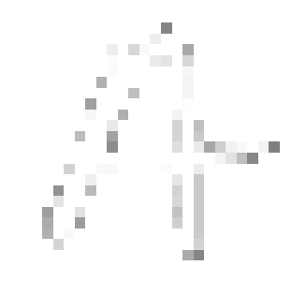
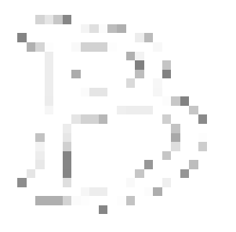

The Goal
1
Build a machine learning model that can read an image of a handwritten alphanumeric character and correctly label it
Can be used to read scanned, handwritten forms
= A
= B
= C

Slide 3
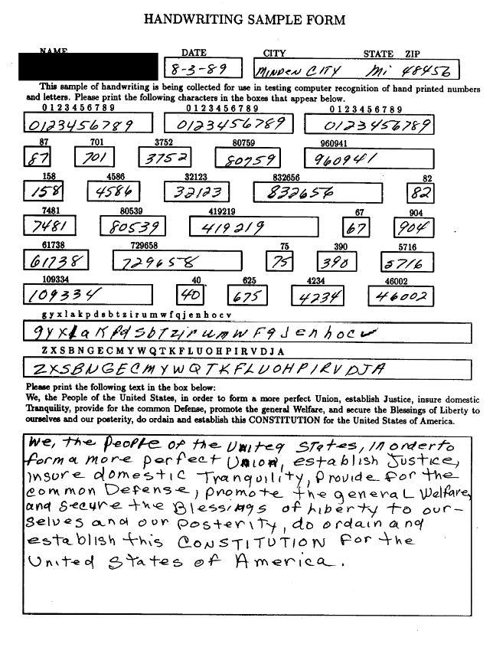
The Data
2
NIST Handprinted Forms and Characters Database
Contains 814,255 images from over 3,600 different writers
Includes numbers, uppercase letters, and lowercase letters
All images are 128 x 128 pixels

Slide 4
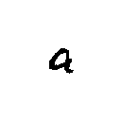

Encoding
3
Images must be converted to a format readable by a program
General idea:
Crop image
Lower image resolution
Interpret image as 2D array of values
Flatten into 1D array
[[0, 0, 0, ..., 0],
[0, 0, 0, ..., 0],
[0, 0, 0, ..., 0],
[0, 0, 0, ..., 0],
[0, 0, 0, ..., 0],
...
[0, 0, 0, ..., 0]]
[0, 0, 0, 0, 0, 0,
0, 0, 0, 100, 255,
255, ..., 80, 0, 0]

Slide 5


Encoding Algorithm
Crop the image as tightly as possible
Make the image square by padding out the sides
Downsize image
Encode as array of darkness values
[0, 0, 0, 0, 0, 0,
0, 0, 0, 100, 255,
255, ..., 80, 0, 0]

Slide 6
File Size Reduction
Data size needed to be kept low to work within memory/storage constraints
Features were kept between 0 and 255 and stored as unsigned 8-bit integers to save space
Data was stored as a .parquet file
Number of cells:
834,611,375
Final file size:
216 MB

Slide 7
Data Exploration
4
Data could now be loaded into pandas
Features were normalized to floating-point values between 0 and 1
 | px0-0 | px0-1 | px0-2 | px0-3 | px0-4 | px0-5 | … | px31-27 | px31-28 | px31-29 | px31-30 | px31-31 | label
0 | 0.0 | 0.0 | 0.0 | 0.0 | 0.0 | 0.0 | … | 0.0 | 0.0 | 0.0 | 0.0 | 0.0 | 0
1 | 0.0 | 0.0 | 0.0 | 0.0 | 0.1 | 0.2 | … | 0.0 | 0.0 | 0.0 | 0.0 | 0.0 | 0
2 | 0.0 | 0.0 | 0.0 | 0.0 | 0.3 | 0.4 | … | 0.2 | 0.1 | 0.0 | 0.0 | 0.0 | 0
… | … | … | … | … | … | … | … | … | … | … | … | … | …
814252 | 0.0 | 0.0 | 0.0 | 0.1 | 0.2 | 0.4 | … | 0.3 | 0.2 | 0.1 | 0.0 | 0.0 | z
814253 | 0.0 | 0.0 | 0.0 | 0.0 | 0.2 | 0.3 | … | 0.3 | 0.1 | 0.0 | 0.0 | 0.0 | z
814254 | 0.0 | 0.0 | 0.0 | 0.0 | 0.0 | 0.0 | … | 0.0 | 0.0 | 0.0 | 0.0 | 0.0 | z

Slide 8
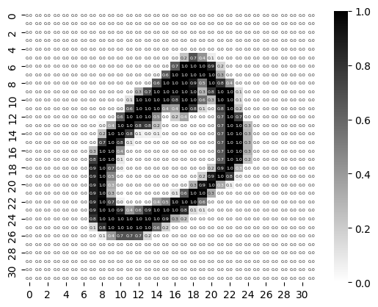
Interpreting Rows as Images
Each row in the data set can be interpreted as an image
0 is white, 1 is black, in between is gray

Slide 9
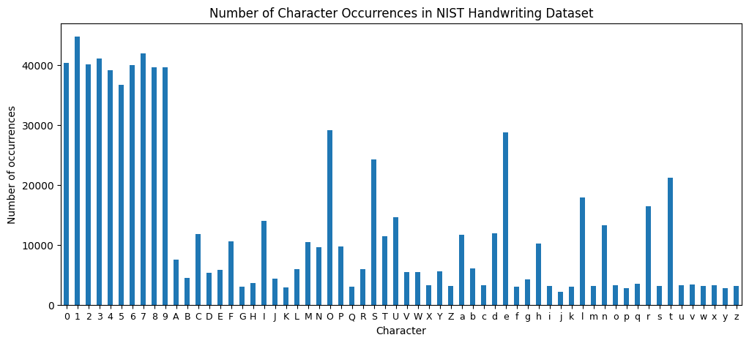
Distribution of Data

Slide 10
Training and Testing Sets
5
Data set was shuffled
20% of the data was assigned to the testing set
Labels were mapped to integers between 0 and 61 for use in the machine learning model
Training set:
651,404 rows
Testing set:
162,851 rows

Slide 11
The Neural Network
6
Multi-class classification problem
Features: 1024 pixel values between 0 and 1
Label: Integer between 0 and 61 corresponding to an alphanumeric character
Output of a prediction: Softmax probability distribution

Slide 12
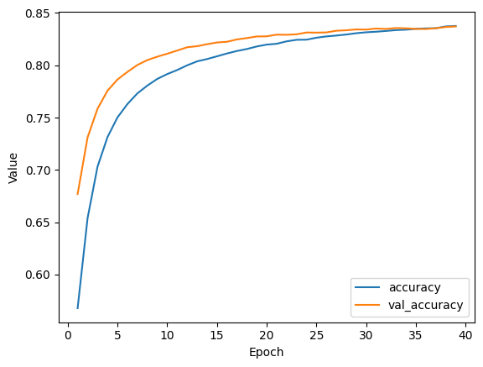
Training the Neural Network
20% of training data used as validation set
Layers:
Input layer
Hidden layer: 256 neurons
Hidden layer: 128 neurons
Hidden layer: 64 neurons
Dropout regularization layer
Output layer: 62 neurons
40 epochs
0.002 learning rate
0.35 dropout rate

Slide 13
Evaluating the Model
7
84%
accuracy rate
The model made correct predictions on the testing data about 84% of the time.

Slide 14
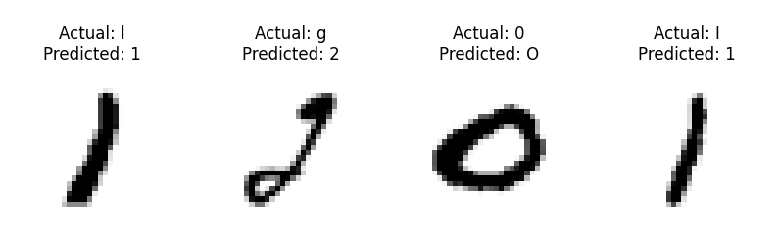
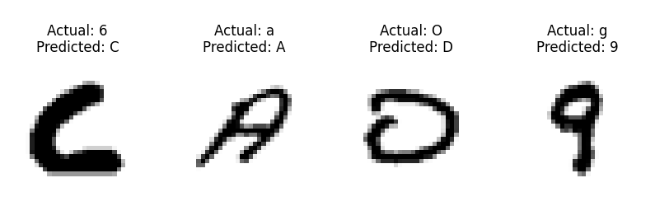
Examples of Incorrect Predictions
Commonly confused characters:
0, O, and o
1, I, and l
Sources of errors:
Reduced detail from low image resolution
Visually indistinguishable characters
Poor handwriting

Slide 15
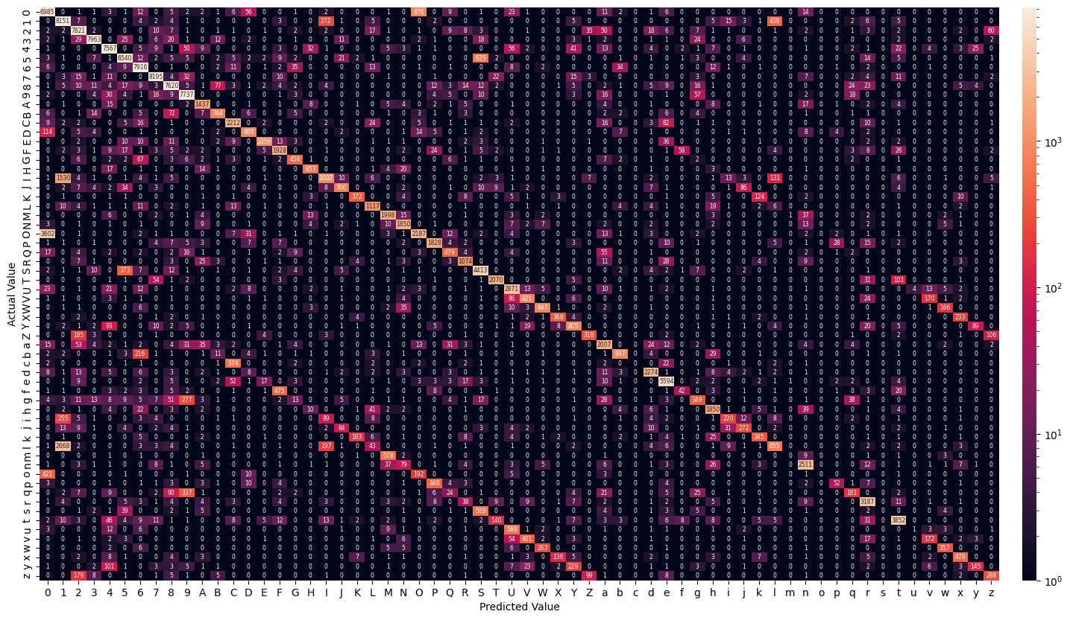
Confusion Matrix

Slide 16
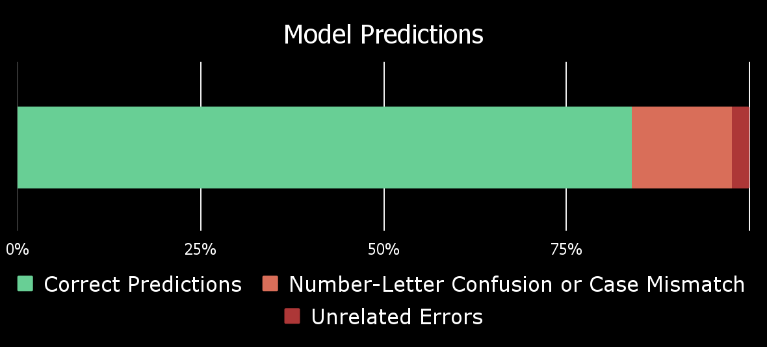
Common Errors
About 60% of incorrect predictions resulted from confusing numbers and letters
25% of incorrect predictions resulted from mismatching letter case

Slide 17
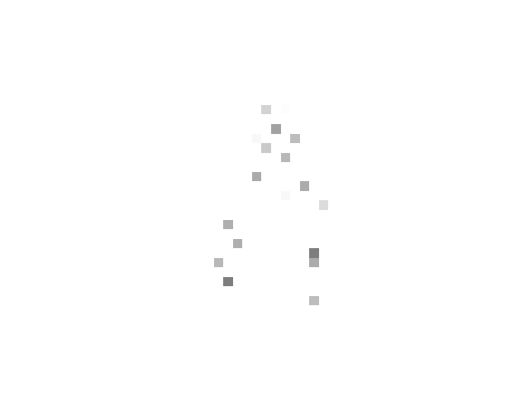


Further Testing of the Model
8
What would happen if we generalized the model to new data?
= ?
= ?
= ?

Slide 18
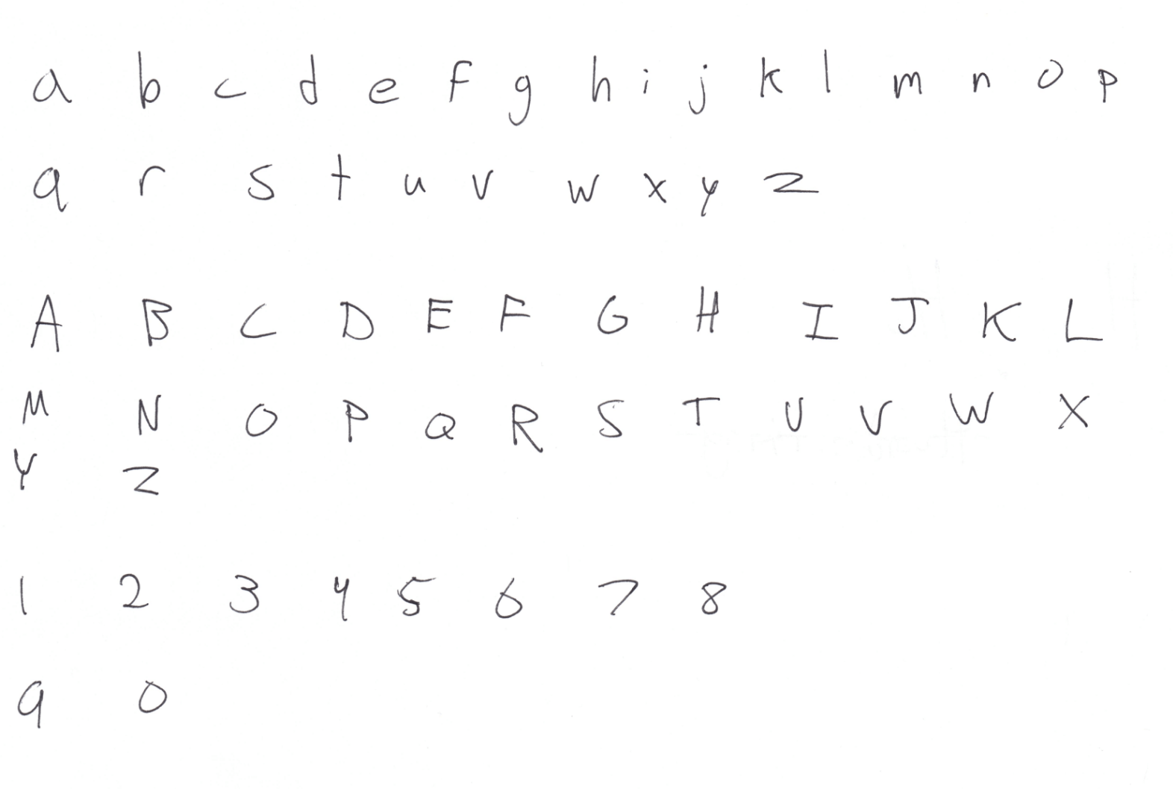
My Handwriting
I wrote one of each alphanumeric character
Scanned and encoded them the same way as the original data

Slide 19
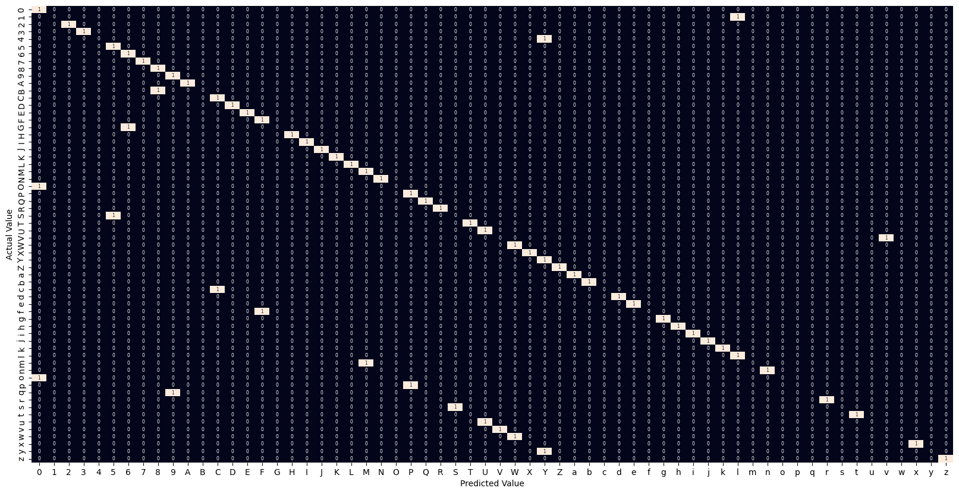
Confusion Matrix

Slide 20
Accuracy of Model on New Data
Model achieved 70% accuracy on my handwriting
Reasons for reduced accuracy:
My handwriting is bad
Low sample size
Different data distribution
Different scanning, encoding, and normalizing process than data on which model was trained
62
samples
70%
accuracy rate

Slide 21
Conclusion and Possible Improvements
9
Accuracy lied between 83%-84% at best - how to raise it?
More epochs = higher accuracy, but training takes much longer
Next time, I would try a convolutional neural network
Demonstrate high success in computer vision problems
Could take into account data in neighboring pixels
Some inaccuracy resulted from normalization/encoding
Reduced size meant reduced detail
Encoding algorithm removed size disparities that distinguished letters

Slide 22
Future Applications
How to avoid the most common errors in practice:
1. Differently trained models for different fields
Most fields use only numbers or only letters, not both
No need to expect letters in a numeric field, or vice versa
Would remove 60% of incorrect predictions
2. Loss of case sensitivity
Many mistakes resulted from confusing uppercase and lowercase forms of letters
Case sensitivity is nonessential in most forms
Would remove 25% of incorrect predictions

Slide 23
Thank you

